Slide 1
Simple Forum
Software Studio 軟體設計與實驗
Hung-Kuo Chu
Department of Computer Science
National Tsing Hua University
CS2410

Slide 2
Simple Forum

Slide 3
Goal
Fork the repo Lab07-Simple Forum to your local repository.
Create a real-time forum by completing all TODOs
Create a new Firebase project name it Lab07 -[student-id] and change parameters in config.js
Complete button events in signin.js so that it has two ways to login/sign-up including email and google

Slide 4
Goal (Cont'd)
Complete logout button function and show alert when logout success or error
Let post button can push a new post to database
Show all post in database on webpage
After finishing all TODOs, deploy your forum to Firebase.
Recommend you to run a local server for testing and use Firefox as testing browser.

Slide 5
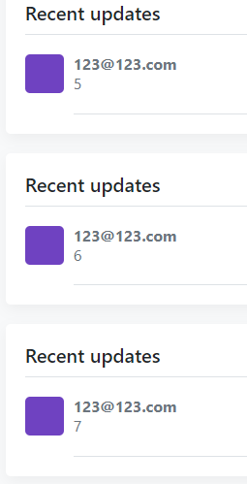
Firebase Database read/write

Slide 6
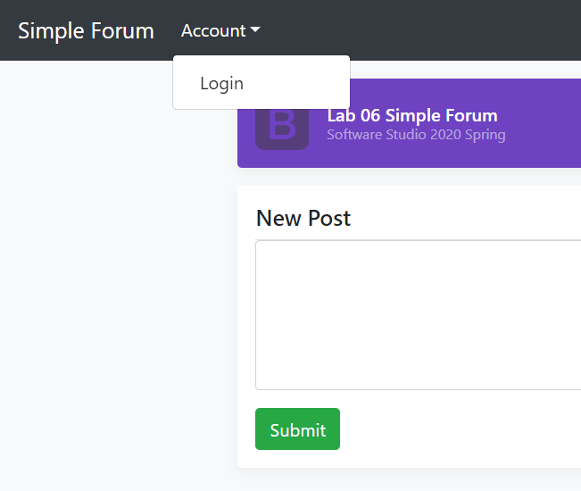
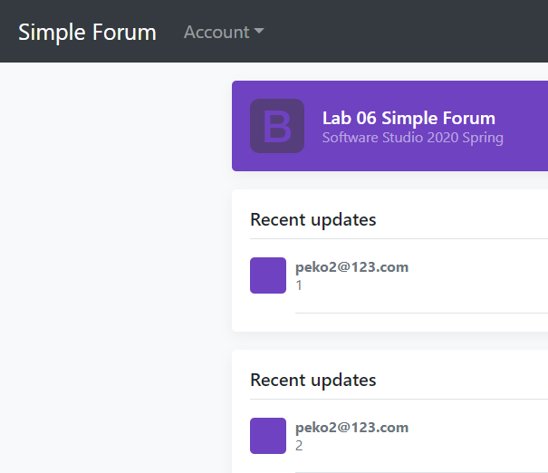
Database rule
未登入: 不顯示訊息
已登入: 顯示訊息

Slide 7
Grading Policy
TODO | Content | Score
1 | Setup Firebase project and connect to your local project | 15 %
2~5 | Firebase Auth | 40 %
6~7 | Firebase Database write Firebase Database read | 20 %
8 | Firebase Database rule (Hint : https://reurl.cc/O1VzYv) | 10 %
 | Firebase Hosting deploy | 15 %

Slide 8
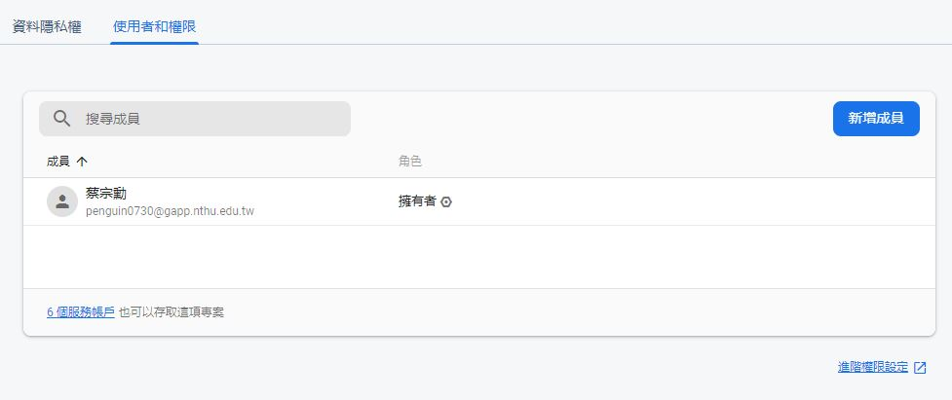
Add permission to TA’s account
Go project setting and select “Users and permissions”

Slide 9
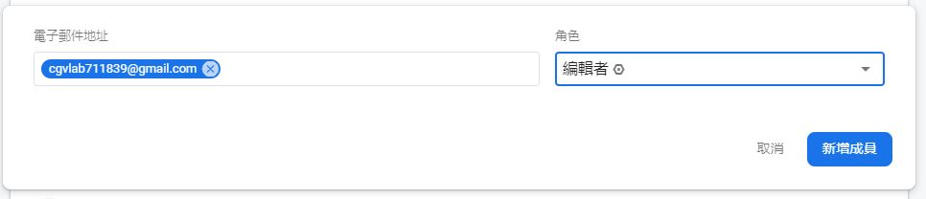
Add permission to TA’s account
Add cgvlab711839@gmail.com as editor to your project.

Slide 10
Goal (Cont'd)
Deadline: 17:20 (commit time)
Deploy Firebase Hosting failed will get 0 point
Deploy delay is seen as commit delay
Please add TA’s account to your Firebase project or you will get 0 point.

